Slide 1
Formal Verification in Reinforcement Learning

Slide 2
Why Verification / Motivation
Overview Formal Verification (Model Checking, SMT, LTL, …)
SMT Example
Use Case
Challenges
Different Types of Verification + Example
Neural Networks Verification?
(Safe RL)
Paper1, Paper2, …
Open Questions
Problems
Own Thoughts / Opinion

Slide 3
//Topics
Introduction
Overview Verification and Reinforcement Learning
//→ NASA Paper
Research Question: How do we handle unknown situations?
//We should be then more specific. e.g. safe online learning, online verification, ...
State of the Art / Related Research + Bottlenecks/Problems
E.g. penality based approaches don‘t make accidents disappear but just very rare + not possible for safe online learning (since you need to learn first not to do an accident)
Proposed Method
Experiments?
Next steps / Problems / Conclusion

Slide 4
//Introduction
Why is this topic relevant
What are the challenges
Motivation from other fields where formal verification succeeded
Use cases: (Not only) Autonomous Driving

Slide 5
//Why Formal Verification?
Safety
During learning, unsafe policies are explored
poor initial performance → faster learning
Ensure that learning does not cause harm
Ensure that a (learned) policy ”works”
Exploit domain knowledge
Ensure reachability

Slide 6
//Research Question
How can we ensure that the model will always act in a safe way? (not damaging something)
How can we deal with uncertain situations?
Does Formal Verification make autonomous driving 100% safe?
Other Questions we could name (but not address)
“Small perturbation of input will not affect the learning“

Slide 7
//Introduction to Formal Verification
Rough overview over methods
PRISM, System monitors, ...
Maybe name some approaches for autonomous driving
I would treat formal verification as a “black box“ in our setting.
Differential Dynamic Logic

Slide 8
SMT Simple Verification Example

Slide 9
Verification of Neural Networks
Adversarial examples
For example: https://arxiv.org/pdf/1707.08945.pdf
SMT, …

Slide 10
//Formal Verification and RL
Nasa paper
What can be verified? What different kind of learning (offline, online) and verification methods are there?
Specify what we want to verifiy / do?
“Model will always be in a non-dangerous state according to “

Slide 11
//Notes
In general: Inject Domain Knowledge into the problem

Slide 12
//State of the Art
Survey (everything pre 2013)
Paper we collected...
Discrete MDPs
Continuous spaces
Model-based RL

Slide 13
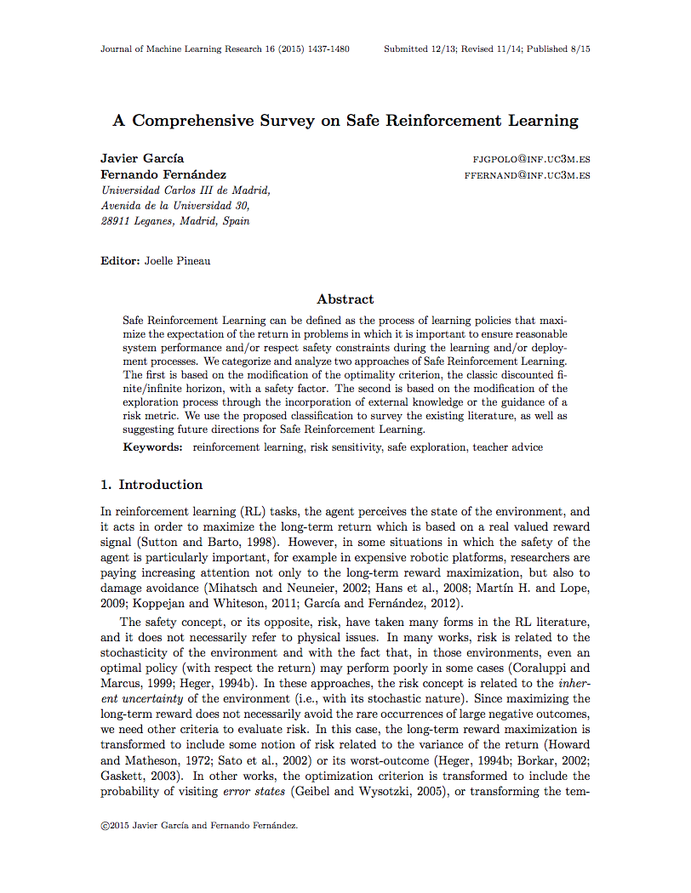
A Comprehensive Survey on Safe Reinforcement Learning (≤ 2015)
…

Slide 14
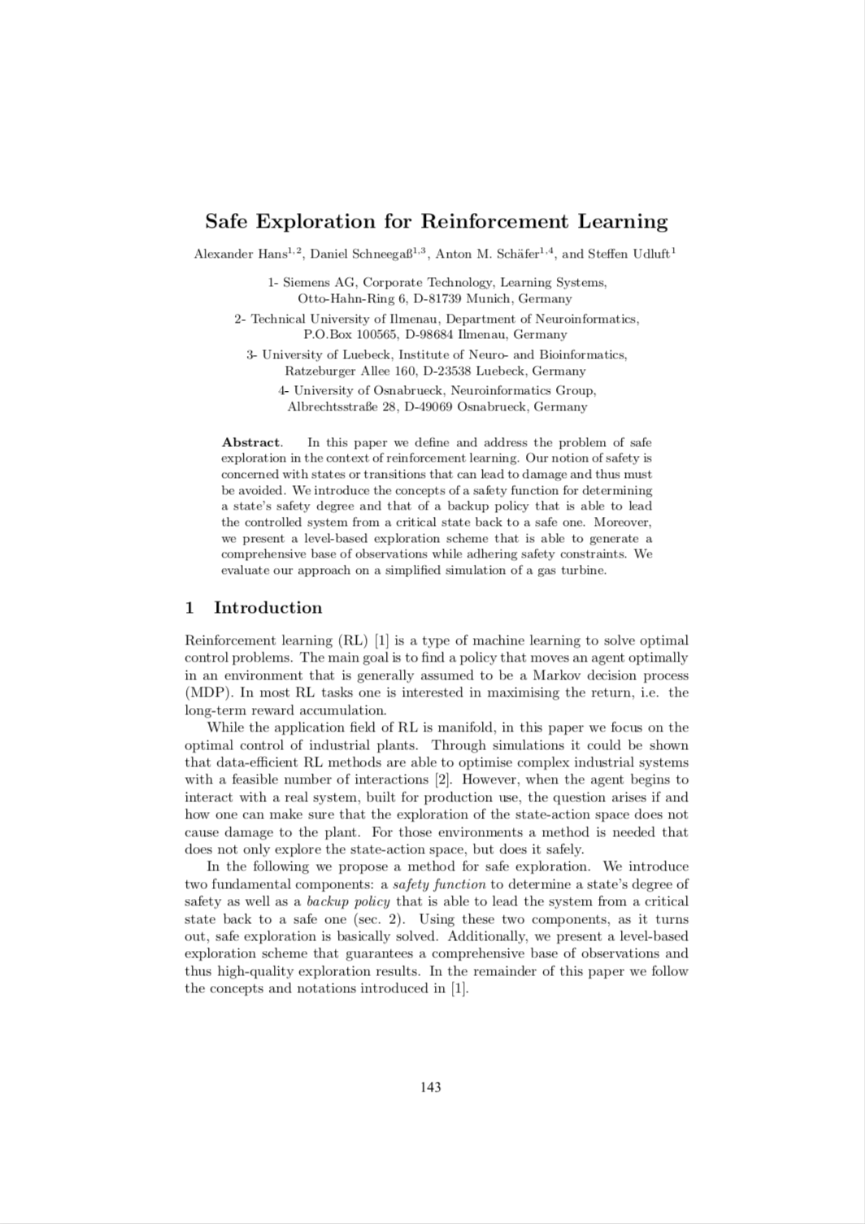
Safe Exploration for Reinforcement Learning (2008)
See Survey...
TODO: sort

Slide 15
Optimization Criterion
Classical criterions: maximize expected return
Can we modify this to make the learning “safer”?

Slide 16
Worst Case Criterion
Maximize worst-case return to reduce variability by the policy
In practices too harsh

Slide 17
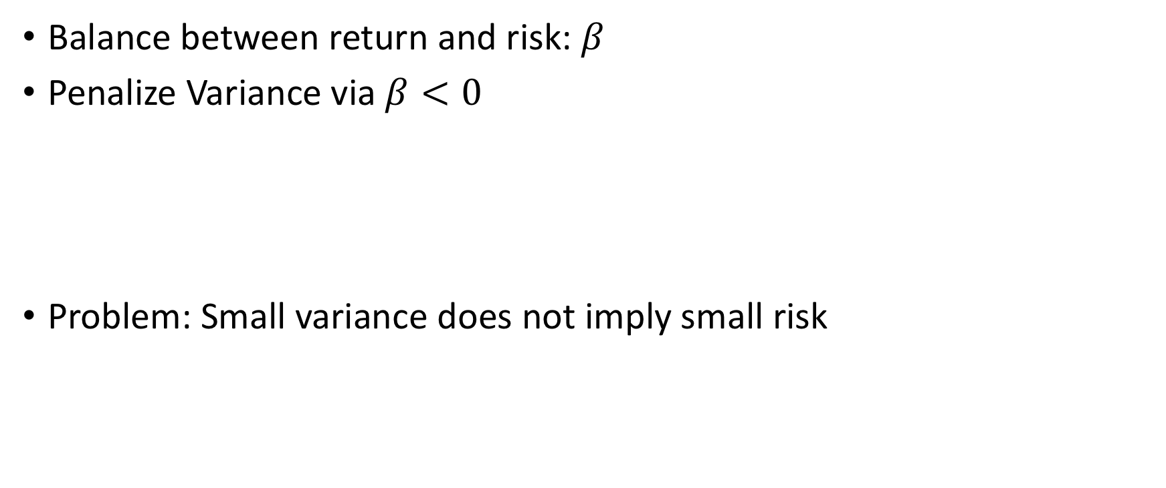
Risk-Sensitive Criterion
Balance between return and risk: $β$
Penalize Variance via $β<0$
Problem: Small variance does not imply small risk

Slide 18
Constrained Criterion
Maximize return subject to given constraints

Slide 19
Constrained Criterion
General strategy: Find equivalent non-constrained problem for given constrained one
Constrains usually only use expectation and variance

Slide 20
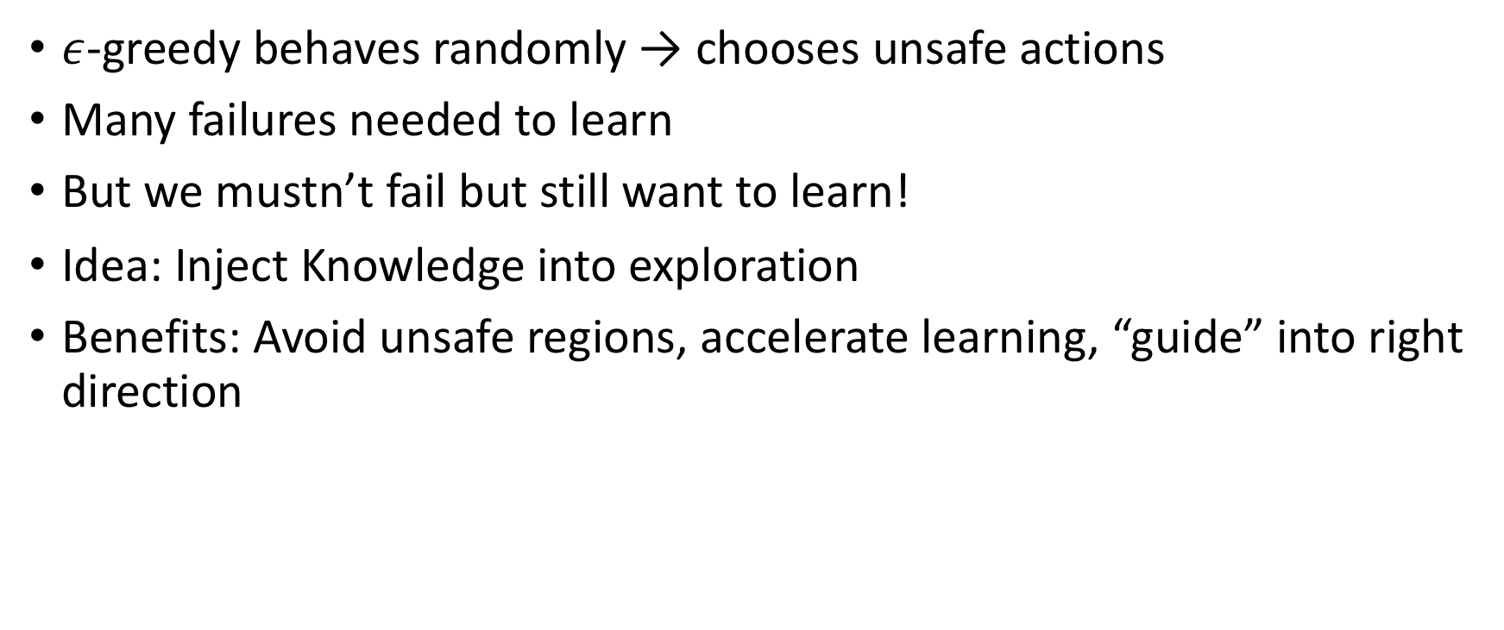
Modification of the Exploration Process
$ε$-greedy behaves randomly → chooses unsafe actions
Many failures needed to learn
But we mustn’t fail but still want to learn!
Idea: Inject Knowledge into exploration
Benefits: Avoid unsafe regions, accelerate learning, “guide” into right direction

Slide 21
Initial Knowledge
Accelerate training

Slide 22
Demonstrations
Use demonstrations to derive a policy

Slide 23
Teacher
Teacher can help agent
Interaction between teacher and agent
If learner is ”unsure”
If teacher thinks it needs to

Slide 24
Teacher Advice

Slide 25
Risk-directed exploration
Use risk-measure for action selection

Slide 26
Lyapunov Functions

Slide 27
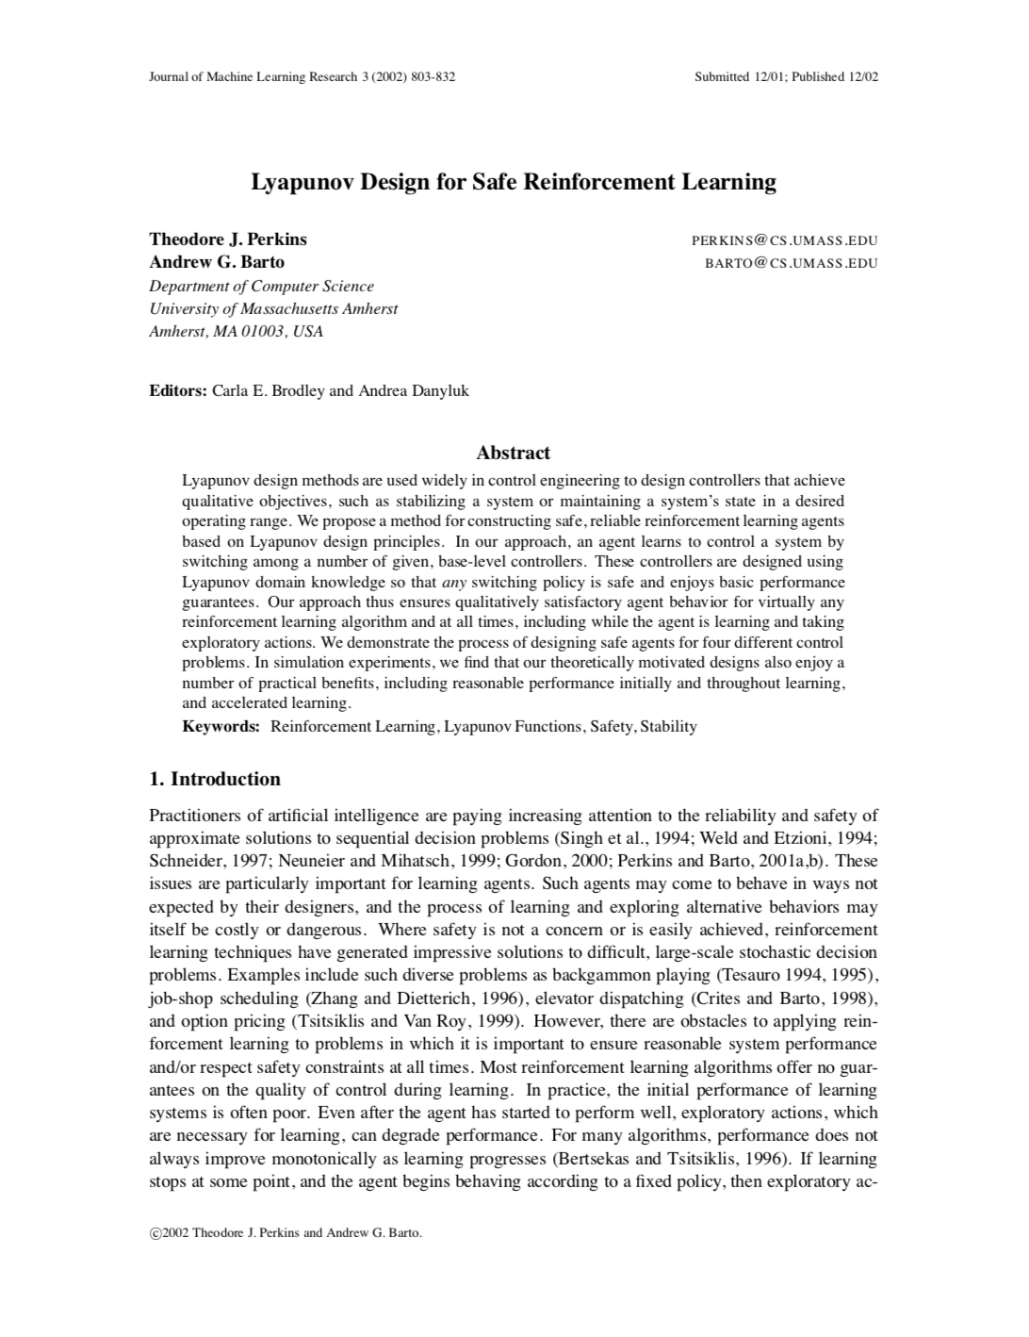
Lyapunov Design for Safe Reinforcement Learning (2002)
Optimal Control Problems
Works with any RL Algorithm
Idea: For a given problem, define actions that ensure any action will keep agent in safe state and moves it eventually there
Use RL to find a good combination of these actions
Problem: You need to come up with these actions by yourself

Slide 28
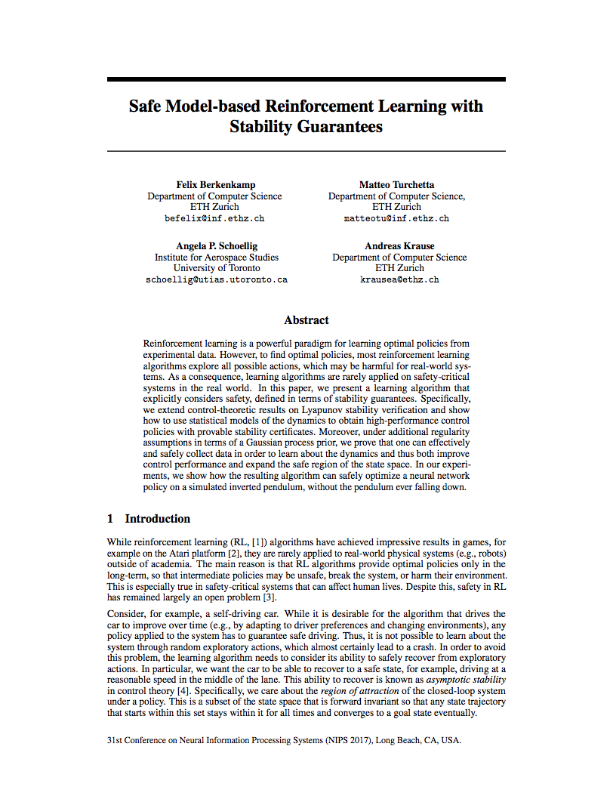
Safe Model-based Reinforcement Learning with Stability Guarantees (2017)
Main Idea: Be able to recover from every situation: “Asymptotic Stability”
Start with an initial, safe policy
Compute “region of attraction” via Lyapunov functions
Exploration will increase safe region and region of attraction

Slide 29
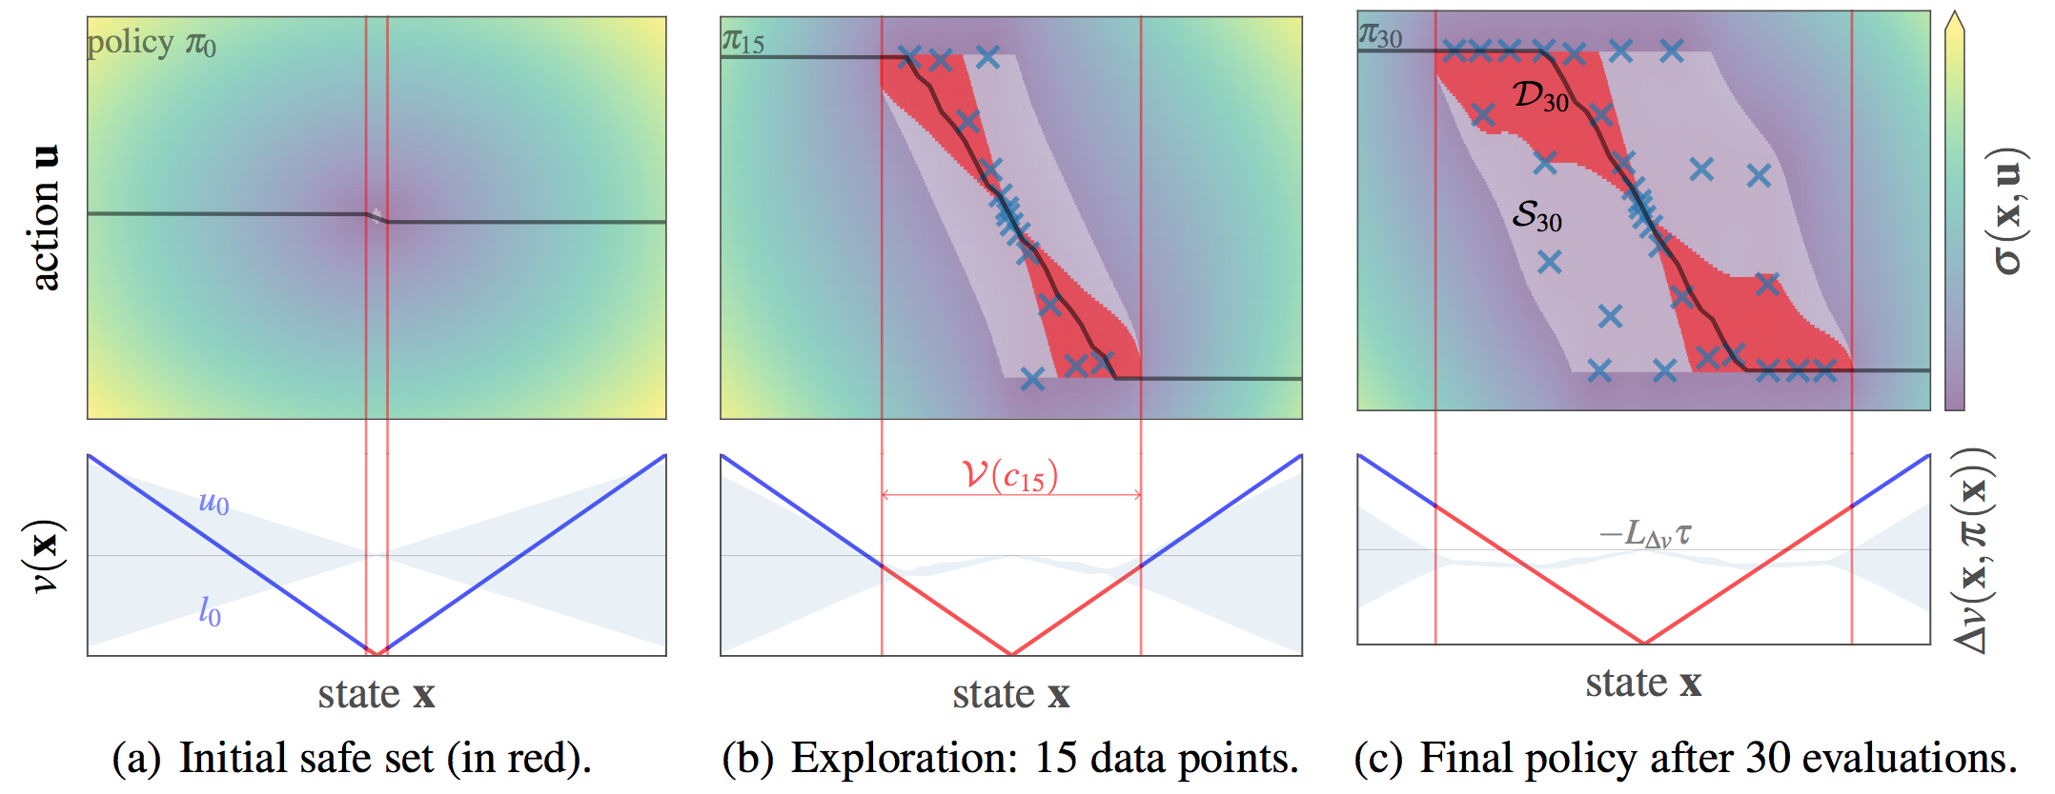
Region of Attraction

Slide 30
Problems
Safety in terms of probability. Probabilities can fail
Example: 99.999% it works, there are 1 000 000 drivers → it won’t stay safe for 10 drivers

Slide 31
Differential Dynamic Logic

Slide 32
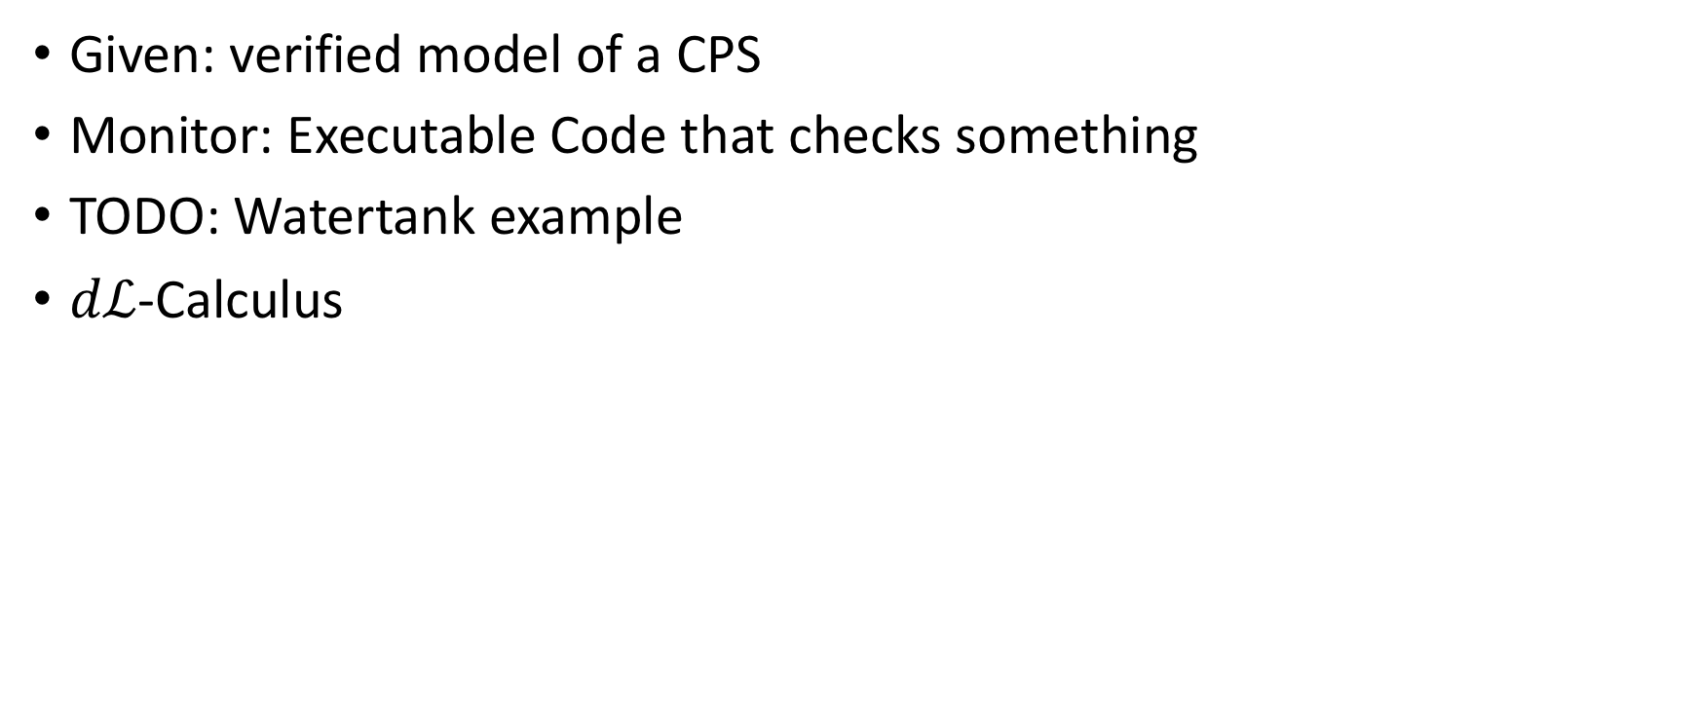
ModelPlex
Given: verified model of a CPS
Monitor: Executable Code that checks something
TODO: Watertank example
$dℒ$-Calculus

Slide 33
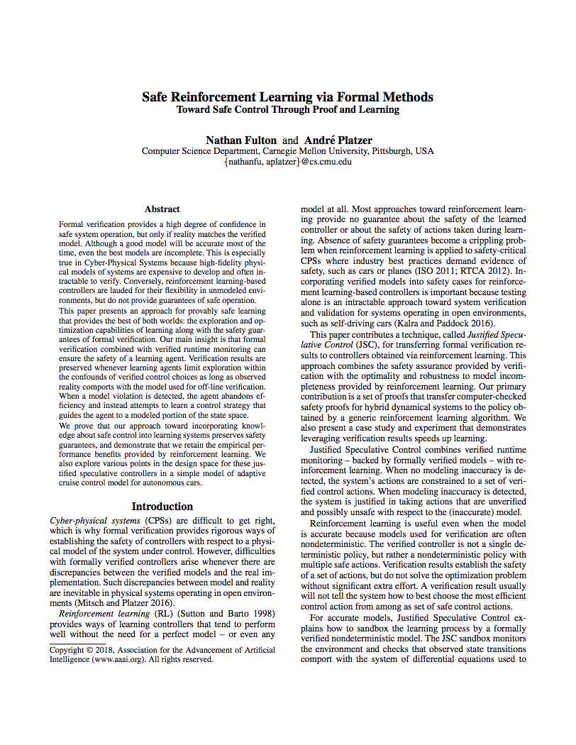
Safe Reinforcement Learning via Formal Methods (2018)
Model accurate: Choose safe action that maximizes reward
Model inaccurate: Choose any action that maximizes reward
Model Monitor: Is the model accurate?
Controller Monitor: Is an action safe?
Any safe action keeps the system safe

Slide 34
Model might not reflect reality due to
Sensor errors
Mechanics malfunctions
Wrong (too simple) assumptions which do not hold in real life

Slide 35
Algorithm
JSCGeneric(init, (S,A,R,E), choose, update, done, CM, MM) {
prev := curr := init;
a0 := NOP;
while (!done(curr)) {
if (MM(prev, a0, curr))
u := choose({a ∈ A | CM(a,curr)});
else
u := choose(A);
prev := curr;
curr := E(u, prev);
update(prev, u, curr);
}
}

Slide 36
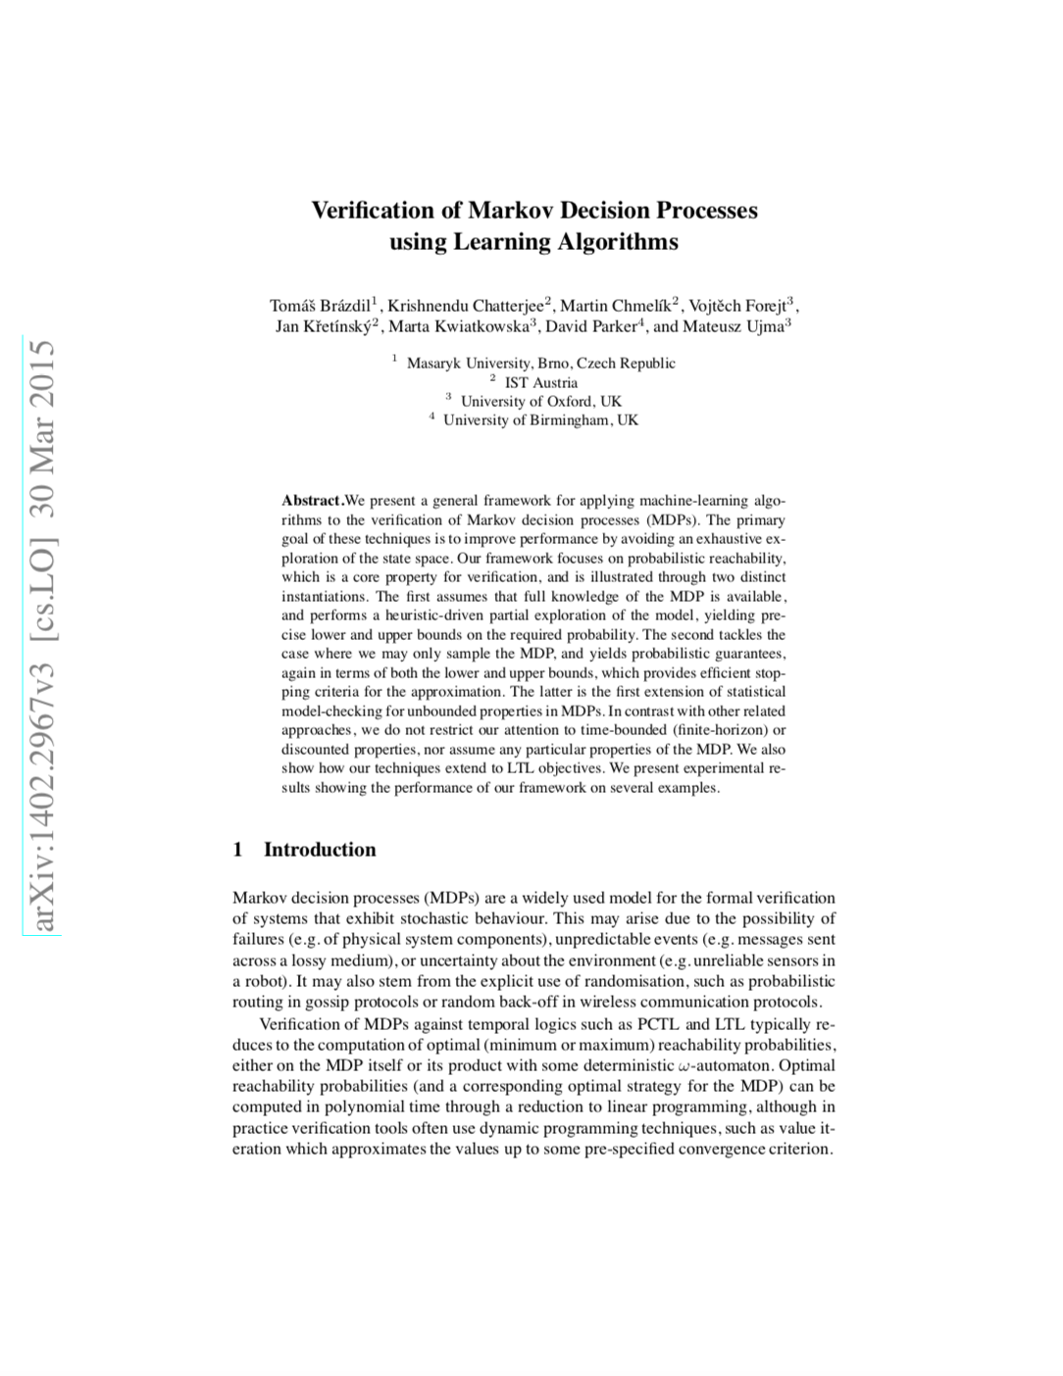
Verification of Markov Decision Processes using Learning Algorithms (2015)
?

Slide 37
DAGGER

Slide 38
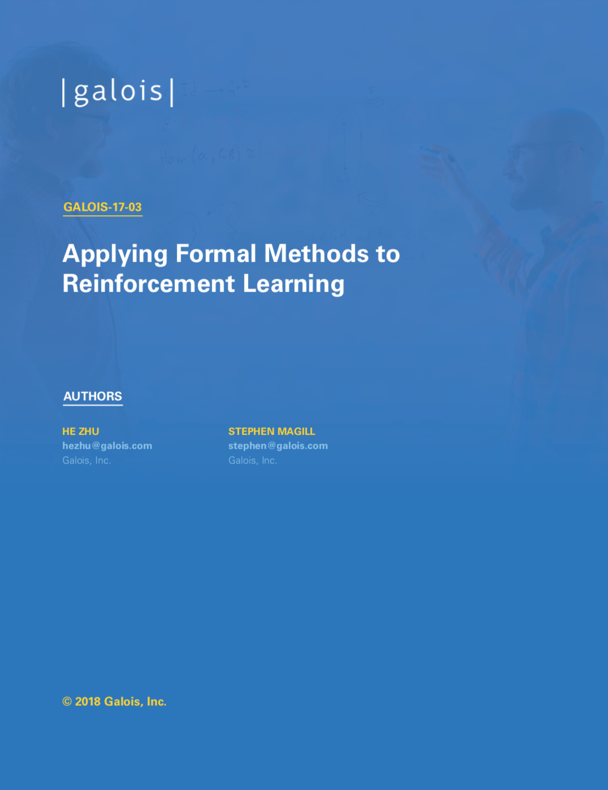
Applying Formal Methods to Reinforcement Learning (2018)
Learn from demonstrations
Problem 1: Agent may encounter unseen situations
Solution: Dataset-Aggregation
Problem 2: Generate “expert” trajectories automatically
Solution: Reward function synthesis using formal methods.

Slide 39
//Proposed Method
Name some ideas?
Advantages and disadvantages
Boost safe method with formal verification
Show that a certain approach does not work
...

Slide 40
//Formal Verification – The solution?
Conclusion, Research Direction, ...
Short discussion on the research questions
Why formal verification does not make driving 100% save

Slide 41
General Problems
Domain knowledge might be wrong
Model might not reflect reality
Constraints are hard to come up with
Probabilities
numeric errors → Verification of the implementation
Assumptions might be violated (or not considered!)
Continuity of dynamics, i.i.d., …

